Slide 1
بنام خدا

Slide 2

apple

Slide 3

carrot

Slide 4

orange juice

Slide 5
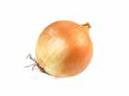
onion

Slide 6

banana

Slide 7

potato

Slide 8

tomato

Slide 9

quince

Slide 10
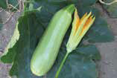
zucchini

Slide 11
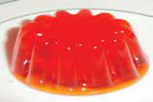
jelly

Slide 12

water

Slide 13

yoghurt

Slide 14

egg

Slide 15
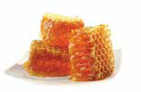
honey

Slide 16
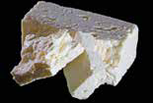
cheese

Slide 17
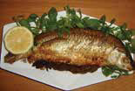
fish

Slide 18

coconut

Slide 19
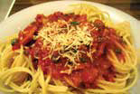
spaghetti

Slide 20

pineapple

Slide 21
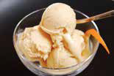
ice cream

Slide 22
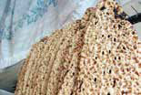
bread

Slide 23
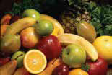
fruit

Slide 24
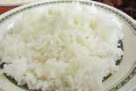
rice

Slide 25

dates

Slide 26
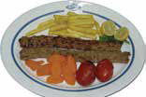
kebab

Slide 27
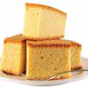
cake

Slide 28
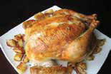
chicken

Slide 29

milk

Slide 30
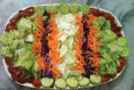
salad

Slide 31

tea

