Slide 1








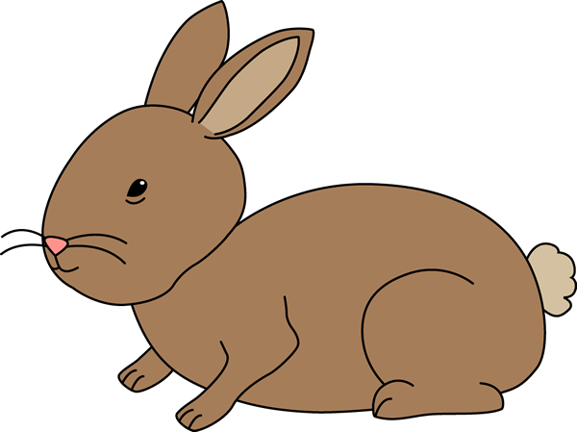

EASTER ANAGRAMS

Slide 2
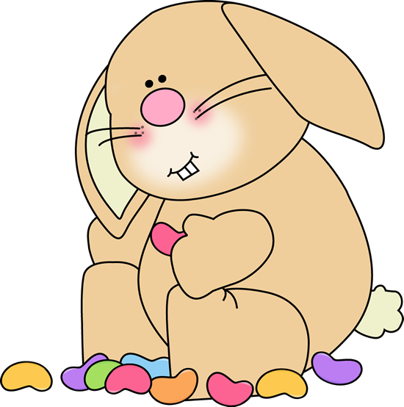
I would like an ________!
……
E E S R T A E G E

Slide 3
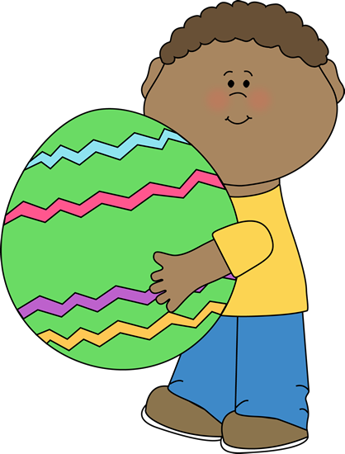
Have you seen the ……?
S E T B A K

Slide 4

I have some …….
for you!
S L O F E R W

Slide 5

What’s in the picture?
C C P U K A E

Slide 6
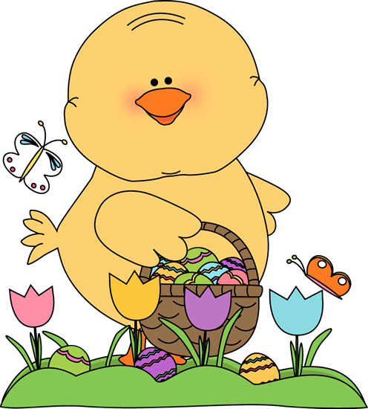
What is the chicken doing? It is on an _ _ _ _ _ _ _!
H E G U G N T

Slide 7
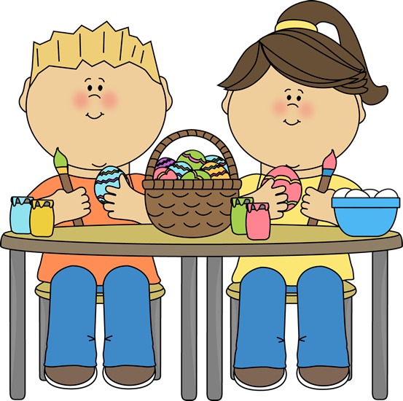
What’ are the kids doing? They are _ _ _ _ _ _ _ _
G I N T N A I P

Slide 8
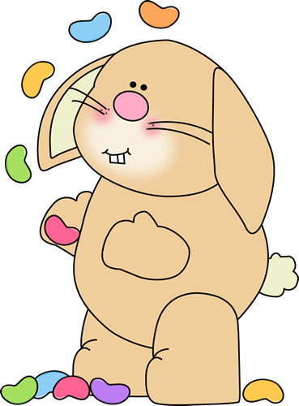
What is the bunny playing with?
N E A S B Y L L J E

Slide 9
HAPPY
EASTER
﻿https://t.me/EnglishZonePowerPoints

