Slide 1

Hello! My name is Tom. This is my typical day!
Click here to download more https://t.me/EnglishZonePowerPoints

Slide 2
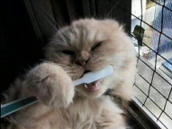

I wake up and I clean my teeth.

Slide 3
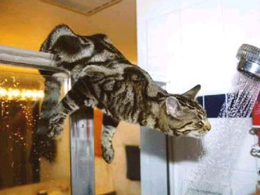

I sometimes take a shower. Mmm! Fantastic!

Slide 4
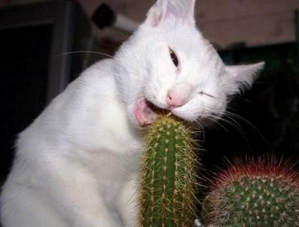

I have breakfast. Hmm… This cactus isn’t very fresh.

Slide 5
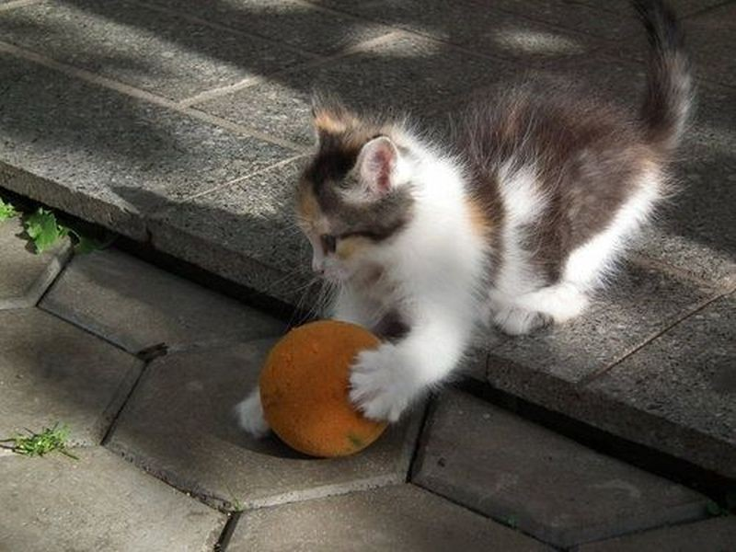
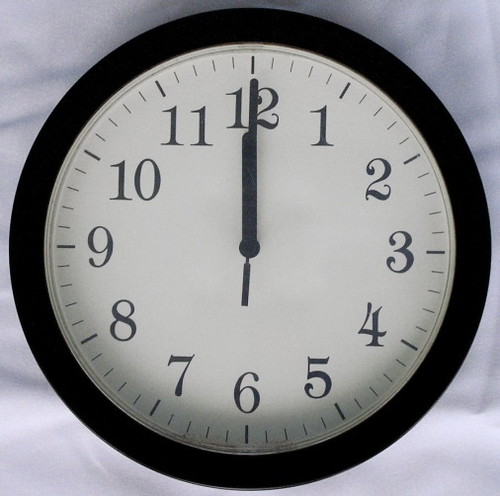
I often do sports. I really like football.

Slide 6
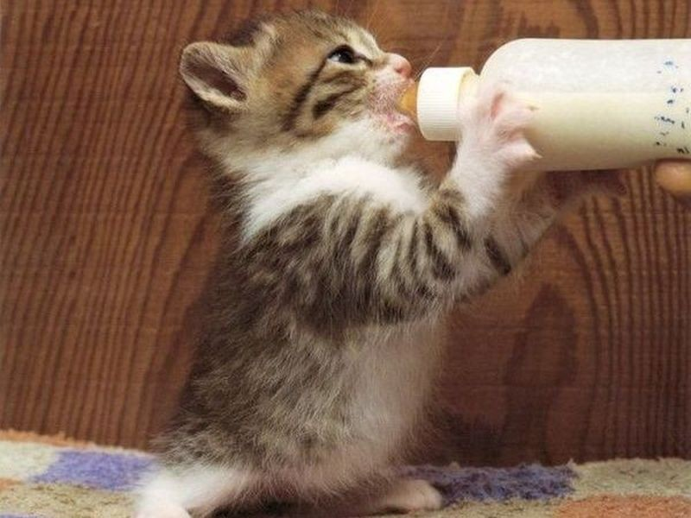

Click here to download more https://t.me/EnglishZonePowerPoints
I drink milk and have lunch.

Slide 7
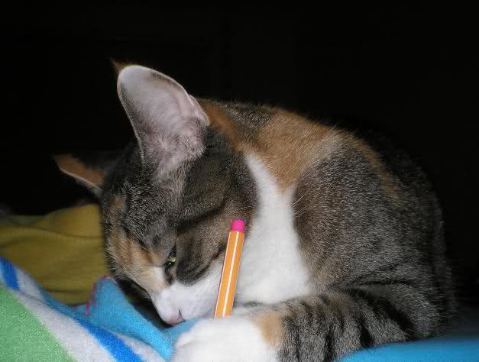
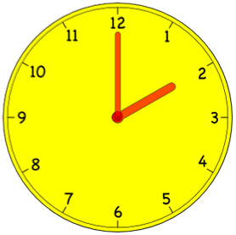
I do my homework. I really hate it.

Slide 8
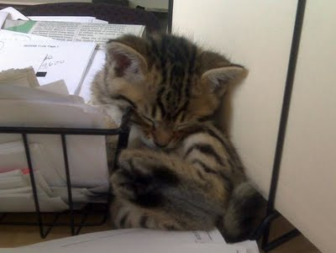

I sleep. I really like to sleep in the afternoon. Zzz…

Slide 9
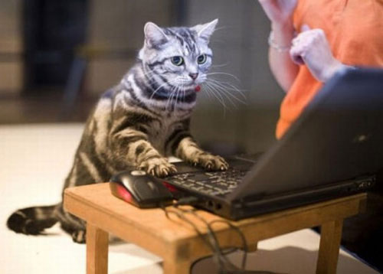
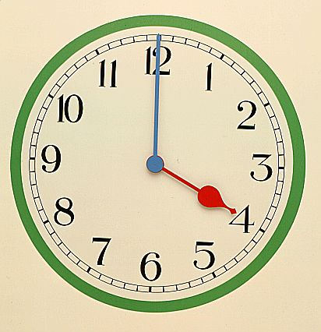
I often play computer games.

Slide 10
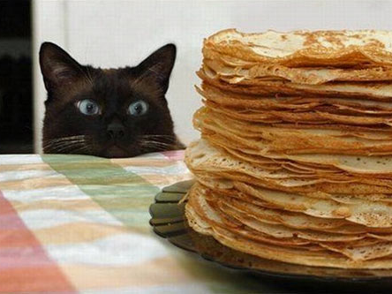

I have dinner! Yummy!

Slide 11
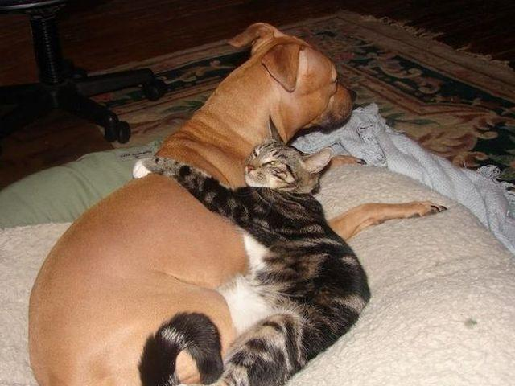

I usually play with my dog. He enjoys it.

Slide 12

I clean my teeth again.
Click here to download more https://t.me/EnglishZonePowerPoints

Slide 13
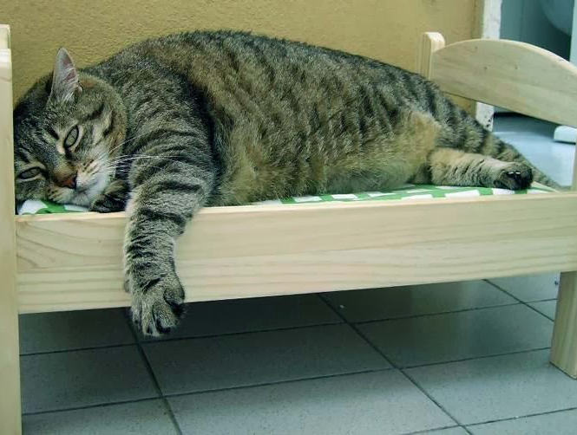

I go to bed.

