Slide 1
A spooky Menu
Special Reading Lesson
click here to download more https://t.me/EnglishZonePowerPoints
Macarena Arévalo Alarcón
English Teacher
Start

Slide 2

Let’s play hangman
A
B
C
D
E
F
G
H
I
J
K
L
M
N
O
P
Q
R
S
T
U
V
W
X
Y
Z
___ ___ ___ ___ ___ ___ ___ ___ ___
___ ___
___ ___ ___ ___
H
A
L
L
O
W
E
E
N
I
S
H
E
R
E
Back
Next

Slide 3
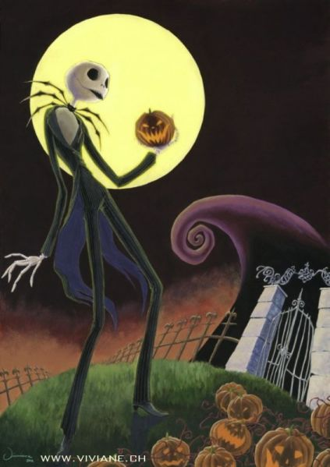
Let’s watch!
Back
Next

Slide 4
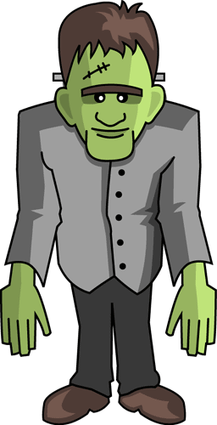





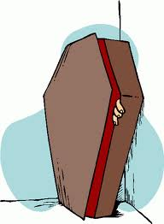
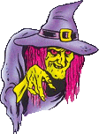

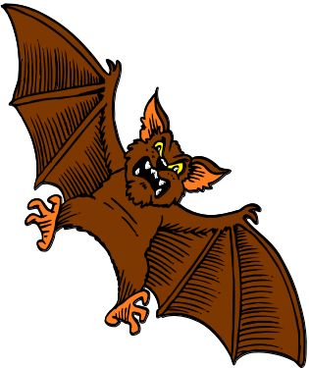
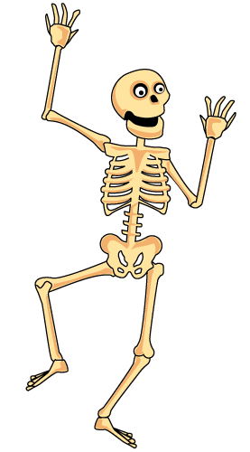
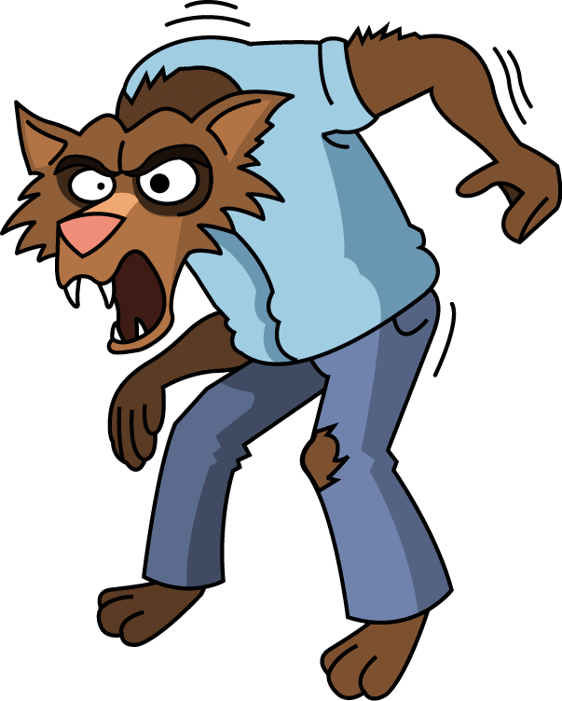

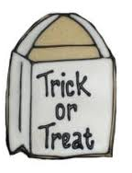

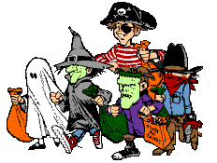


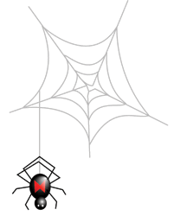
click here to download more https://t.me/EnglishZonePowerPoints
Frankenstein
mummy
black cat
scarecrow
cauldron
ghost
coffin
werewolf
witch
witch hat
bat
skeleton
candies
children
trick or treat bag
jack-o´-lantern
mask
Back
Next
haunted house

Slide 5

Choose the correct alternative
ghost
Try Again
mummy
Great Job!
Skeleton
Try Again
10
9
8
7
6
5
4
3
2
1
End

Slide 6
Choose the correct alternative
ghost
Try Again
Skeleton
Try Again
Black cat
Great Job!
10
9
8
7
6
5
4
3
2
1
End

Slide 7
Choose the correct alternative
ghost
Try Again
witch
Great Job!
Skeleton
Try Again
10
9
8
7
6
5
4
3
2
1
End

Slide 8
click here to download more https://t.me/EnglishZonePowerPoints
Choose the correct alternative
cauldron
Try Again
ghost
Great Job!
Skeleton
Try Again
10
9
8
7
6
5
4
3
2
1
End

Slide 9
Choose the correct alternative
ghost
Try Again
Skeleton
Try Again
coffin
Great Job!
10
9
8
7
6
5
4
3
2
1
End

Slide 10
Choose the correct alternative
ghost
Try Again
children
Great Job!
Skeleton
Try Again
10
9
8
7
6
5
4
3
2
1
End

Slide 11
Choose the correct alternative
ghost
Try Again
bat
Great Job!
Skeleton
Try Again
10
9
8
7
6
5
4
3
2
1
End

Slide 12
Choose the correct alternative
candies
Great Job!
ghost
Try Again
Skeleton
Try Again
10
9
8
7
6
5
4
3
2
1
End

Slide 13

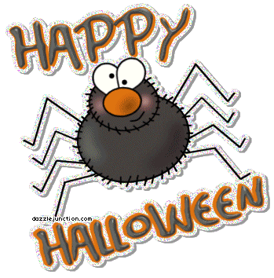
click here to download more https://t.me/EnglishZonePowerPoints
Created by:

