Slide 1
SIMPLE BUSINESS PLAN INFOGRAPHICS
Here is where this template begins

Slide 2
ABOUT SIMPLE BUSINESS PLAN INFOGRAPHICS
This template contains an assortment of complementary infographic resources for the Simple Business Plan presentation.
These infographics are adapted to the style of the aforementioned presentation, so you can insert them easily and have them completely integrated at once. You just need to do the following:
  Select the element that you want to copy
  Right-click and choose “Copy”
  Go to the slide where you want the element to appear
  Right-click and choose “Paste”

Slide 3
SIMPLE BUSINESS PLAN INFOGRAPHICS
Jupiter is a gas giant and the biggest planet in the Solar System
Jupiter
01
02
Mars
Despite being red, Mars is actually a cold place full of iron oxide dust
It’s the third planet from the Sun and the only one that harbors life
Earth
03
04
Mercury
Mercury is the closest planet to the Sun and the smallest one

Slide 4
SIMPLE BUSINESS PLAN INFOGRAPHICS
It’s terribly hot, even hotter than Mercury
It’s the biggest planet in the Solar System
It’s the smallest planet in the Solar System
Venus
Jupiter
Mercury
Earth
Saturn
Mars
It’s the third planet and is where we all live on
Saturn is a gas giant and has several rings
Despite being red, it’s actually a cold place

Slide 5
SIMPLE BUSINESS PLAN INFOGRAPHICS
Mercury
Mars
It’s the smallest planet in the Solar System
Despite being red, it’s actually a cold place
Jupiter
Earth
It’s the biggest planet in the Solar System
It’s the third planet and is where we all live on

Slide 6
SIMPLE BUSINESS PLAN INFOGRAPHICS
Saturn is a gas giant and has several rings
Venus has a beautiful name and is very hot
Jupiter
Earth
Jupiter is the biggest planet
Earth is where we all live on
Mars
Mercury
Mars is actually a cold place
Mercury is the smallest planet
Venus
It’s even hotter than Mercury

Slide 7
SIMPLE BUSINESS PLAN INFOGRAPHICS
Saturn
Mars
Earth
Venus
Jupiter
Saturn is a gas giant and has several rings
Despite being red, Mars is a cold place
Earth is the planet where we all live on
It’s terribly hot, even hotter than Mercury
It’s the biggest planet in the Solar System
01
02
03
04
05

Slide 8
SIMPLE BUSINESS PLAN INFOGRAPHICS
TOOL 1
Venus
It’s terribly hot, even hotter than Mercury
TOOL 2
Mars
Despite being red, it’s actually a cold place
TOOL 3
Mercury
It’s the smallest planet in the Solar System
TOOL 4
Earth
It’s the third planet and is where we all live on

Slide 9
SIMPLE BUSINESS PLAN INFOGRAPHICS
50%
75%
70%
55%
Saturn
Earth
Venus
Jupiter
Saturn is a gas giant and has several rings
Earth is the planet where we all live on
It’s terribly hot, even hotter than Mercury
It’s the biggest planet in the Solar System

Slide 10
SIMPLE BUSINESS PLAN INFOGRAPHICS
 | MONTH 1 | MONTH 2 | MONTH 3 | MONTH 4
Earth | Mercury is the closest planet | Earth is the third planet | Jupiter is the biggest planet
Mercury | Neptune is the farthest planet
Jupiter | It’s hottest than Mercury | Mars is actually cold
Neptune |  | Mercury is the closest planet | Earth is where we all live on
Saturn |  |  |  | Mercury is the smallest planet

Slide 11
SIMPLE BUSINESS PLAN INFOGRAPHICS
GOAL 01
Saturn
It was named after the Roman god of wealth and agriculture
GOAL 02
Jupiter
Jupiter is a gas giant and the biggest planet in the Solar System
GOAL 03
Earth
It’s the third planet from the Sun and the only one that harbors life
GOAL 04
Mars
Despite being red, Mars is actually a cold place full of iron oxide dust
GOAL 05
Venus
Venus has a beautiful name and is the second planet from the Sun

Slide 12
SIMPLE BUSINESS PLAN INFOGRAPHICS
Saturn
Earth
Venus
Jupiter
Neptune
Saturn has several rings
Earth is where we all live on
It’s even hotter than Mercury
Jupiter is the biggest planet
Neptune is the farthest planet

Slide 13
SIMPLE BUSINESS PLAN INFOGRAPHICS
Strategy 1
Strategy 2
Plan 1
Plan 2
Plan 1
Plan 2
Earth is the planet where we all live on
It’s the biggest planet in the Solar System
Despite being red, Mars is actually cold
It’s terribly hot, even hotter than Mercury
Saturn
Neptune
Mercury
Saturn is a gas giant and has several rings
Neptune is the farthest planet from the Sun
It’s the smallest planet in the Solar System

Slide 14
SIMPLE BUSINESS PLAN INFOGRAPHICS
Mercury
Venus
It’s the smallest planet in the Solar System
It’s terribly hot, even hotter than Mercury
Saturn
Mars
Saturn is a gas giant and has several rings
Despite being red, it’s actually a cold place
Jupiter
Earth
It’s the biggest planet in the Solar System
It’s the third planet and is where we all live on

Slide 15
SIMPLE BUSINESS PLAN INFOGRAPHICS
Earth
Venus
Earth is the planet where we all live on
It’s terribly hot, even hotter than Mercury
Saturn
Mercury
Saturn is a gas giant and has several rings
Mercury is the smallest planet of all them
Jupiter
Mars
It’s the biggest planet in the Solar System
Despite being red, Mars is actually cold

Slide 16
SIMPLE BUSINESS PLAN INFOGRAPHICS
09:00 - 10:00
10:00 - 12:00
Team 01
Team 01
Team 02
Jupiter is a gas giant and the biggest planet in the Solar System
It was named after the Roman god of wealth and agriculture
Team 02
12:00 - 15:00
15:00 - 18:00
Team 03
Team 03
Team 04
It’s the third planet from the Sun and the only one that harbors life
Mercury is the closest planet to the Sun and the smallest one
Team 04

Slide 17
SIMPLE BUSINESS PLAN INFOGRAPHICS
 | Jan | Feb | Mar | Apr | May | Jun | Jul | Aug | Sep | Oct | Nov | Dec
Action 1
Action 2
Action 3
Action 4
Action 1
Action 2
Action 3
Action 4
Jupiter is the biggest planet
Mercury is the smallest planet
Earth is where we all live on
Mars is actually
a cold place

Slide 18
SIMPLE BUSINESS PLAN INFOGRAPHICS
Business plan
Action 01
Action 02
Action 03
It’s the smallest planet in the Solar System
It’s the third planet and is where we all live on
Despite being red, it’s actually a cold place
$200.000
$120.000
$78.000

Slide 19
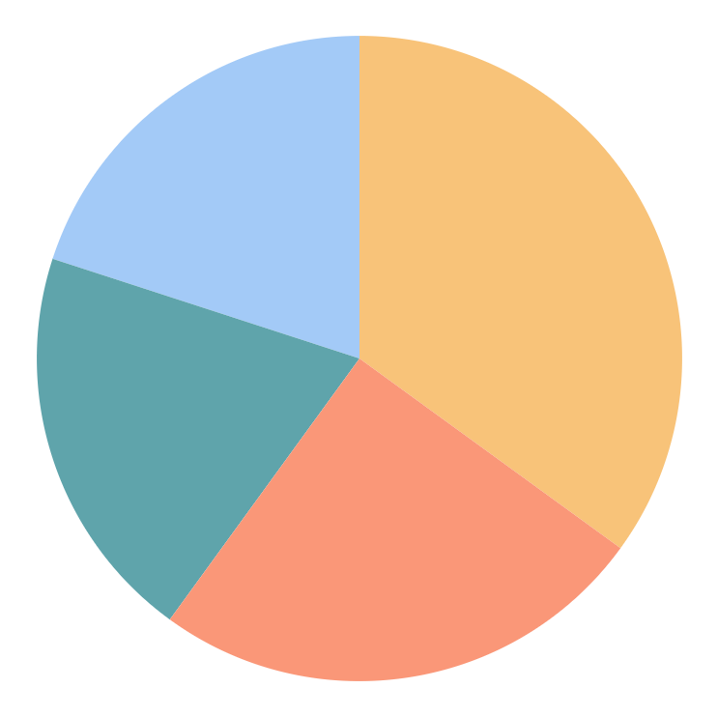
SIMPLE BUSINESS PLAN INFOGRAPHICS
20%
35%
Phase 01
Phase 02
Venus has a beautiful name and is the second planet from the Sun
Mercury is the closest planet to the Sun and the smallest one
25%
20%
Phase 03
Phase 04
Jupiter is a gas giant and the biggest planet in the Solar System
Despite being red, Mars is actually a cold place full of iron oxide dust
Follow the link in the graph to modify its data and then paste the new one here. For more info, click here

Slide 20
SIMPLE BUSINESS PLAN INFOGRAPHICS
Idea
Analysis
Mercury is the closest planet to the Sun and the smallest one
It’s the third planet from the Sun and the only one that harbors life
Work
Risks
Jupiter is a gas giant and the biggest planet in the Solar System
Management plan
It was named after the Roman god of wealth and agriculture

Slide 21
SIMPLE BUSINESS PLAN INFOGRAPHICS
 | Stage 01 | Stage 02 | Stage 03 | Stage 04
Earth is where we all live on
Saturn has several rings
Jupiter is the biggest planet
Mercury is the smallest planet

Slide 22
SIMPLE BUSINESS PLAN INFOGRAPHICS
Saturn
Venus
Earth
Saturn is a gas giant and has several rings
It’s terribly hot, even hotter than Mercury
Earth is the planet where we all live on
01
02
03

Slide 23
SIMPLE BUSINESS PLAN INFOGRAPHICS
Mercury is the smallest planet
Mars is actually a cold place
Jupiter is the biggest planet
Earth is the third planet
Step 01
Step 02
Step 03
Step 04
Saturn
Earth
Neptune
Venus
Jupiter
Saturn is a gas giant and has several rings
Earth is the planet where we all live on
Neptune is the farthest planet from the Sun
It’s terribly hot, even hotter than Mercury
It’s the biggest planet in the Solar System

Slide 24
SIMPLE BUSINESS PLAN INFOGRAPHICS
Summary
Markets
Competitors
It’s the third planet from the Sun and the only one that harbors life
Jupiter is a gas giant and the biggest planet in the Solar System
Despite being red, Mars is actually a cold place full of iron oxide dust
Resources
Suppliers
It was named after the Roman god of wealth and agriculture
Venus has a beautiful name and is the second planet from the Sun

Slide 25
SIMPLE BUSINESS PLAN INFOGRAPHICS
 | Goal 01 | Goal 02 | Goal 03 | Goal 04 | Goal 05
Mercury
Saturn
Earth
Uranus
Saturn
Jupiter
Team 01
Venus is hotter than Mercury
Team 02
Earth is where we all live on

Slide 26
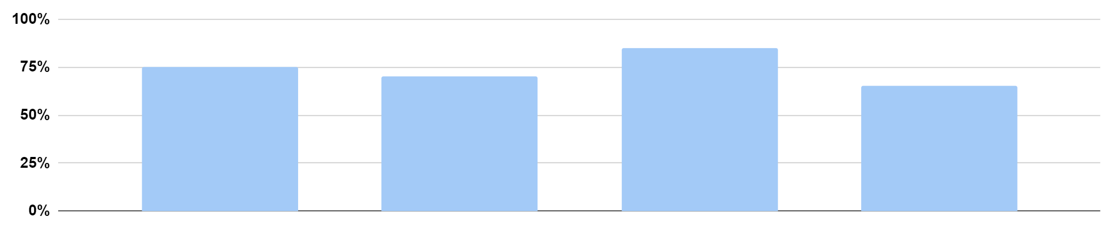
SIMPLE BUSINESS PLAN INFOGRAPHICS
It’s the smallest planet in the Solar System
It’s terribly hot, even hotter than Mercury
Despite being red, it’s actually a cold place
It’s the biggest planet in the Solar System
Year 01
Year 02
Year 03
Year 04
75%
70%
85%
65%
Follow the link in the graph to modify its data and then paste the new one here. For more info, click here

Slide 27
SIMPLE BUSINESS PLAN INFOGRAPHICS
Venus
1
2
Neptune
It’s terribly hot, even hotter than Mercury
2
It’s the farthest planet from the Sun
1
4
Mars
3
4
Saturn
Despite being red, it’s actually a cold place
Saturn is a gas giant and has several rings
3
6
Earth
5
6
Jupiter
5
Earth is the planet where we all live on
It’s the biggest planet in the Solar System

Slide 28
SIMPLE BUSINESS PLAN INFOGRAPHICS
Mars
Earth
Mercury
Despite being red, it’s actually a cold place
It’s the third planet and is where we all live on
It’s the smallest planet in the Solar System

Slide 29
SIMPLE BUSINESS PLAN INFOGRAPHICS
Market research | Business model | Business planning | Develop strategy | Results analysis
Saturn is a gas giant and has several rings | Despite being red, it’s actually a cold place | It’s the third planet and is where we live on | It’s the biggest planet in the Solar System | Venus is terribly hot, even hotter than Mercury
Investment | Investment | Investment | Investment | Investment
$20.000 | $16.000 | $31.000 | $55.000 | $10.000

Slide 30
SIMPLE BUSINESS PLAN INFOGRAPHICS
Plan 01
Plan 02
Action 01
Action 01
Action 02
Action 02
Action 03
Action 03
Action 04
Action 04

Slide 31
SIMPLE BUSINESS PLAN INFOGRAPHICS
 | Phase 01 | Phase 02 | Phase 03 | Phase 04 | Phase 05
It’s the smallest planet
It’s the biggest planet
It’s the farthest planet
It’s the hottest planet
It’s the closest planet

Slide 32
SIMPLE BUSINESS PLAN INFOGRAPHICS
01
Mars
02
Despite being red, it’s actually a cold place
Saturn
Venus
Saturn is a gas giant and has several rings
It’s terribly hot, even hotter than Mercury
04
Jupiter
03
It’s the biggest planet in the Solar System

Slide 33
Instructions for use (premium users)
As a Premium user, you can use this template without attributing Slidesgo.
You are allowed to:
Modify this template.
Use it for both personal and commercial purposes.
Hide or delete the “Thanks” slide and the mention to Slidesgo in the credits.
Share this template in an editable format with people who are not part of your team.
You are not allowed to:
Sublicense, sell or rent this Slidesgo Template (or a modified version of this Slidesgo Template).
Distribute this Slidesgo Template (or a modified version of this Slidesgo Template) or include it in a database or in any other product or service that offers downloadable images, icons or presentations that may be subject to distribution or resale.
Use any of the elements that are part of this Slidesgo Template in an isolated and separated way from this Template.
Register any of the elements that are part of this template as a trademark or logo, or register it as a work in an intellectual property registry or similar.
For more information about editing slides, please read our FAQs or visit Slidesgo School:
https://slidesgo.com/faqs and https://slidesgo.com/slidesgo-school

Slide 34
Infographics
You can add and edit some infographics to your presentation to present your data in a visual way.
Choose your favourite infographic and insert it in your presentation using Ctrl C + Ctrl V or Cmd C + Cmd V in Mac.
Select one of the parts and ungroup it by right-clicking and choosing “Ungroup”.
Change the color by clicking on the paint bucket.
Then resize the element by clicking and dragging one of the square-shaped points of its bounding box (the cursor should look like a double-headed arrow). Remember to hold Shift while dragging to keep the proportions.
Group the elements again by selecting them, right-clicking and choosing “Group”.
Repeat the steps above with the other parts and when you’re done editing, copy the end result and paste it into your presentation.
Remember to choose the “Keep source formatting” option so that it keeps the design. For more info, please visit Slidesgo School.

