Slide 1
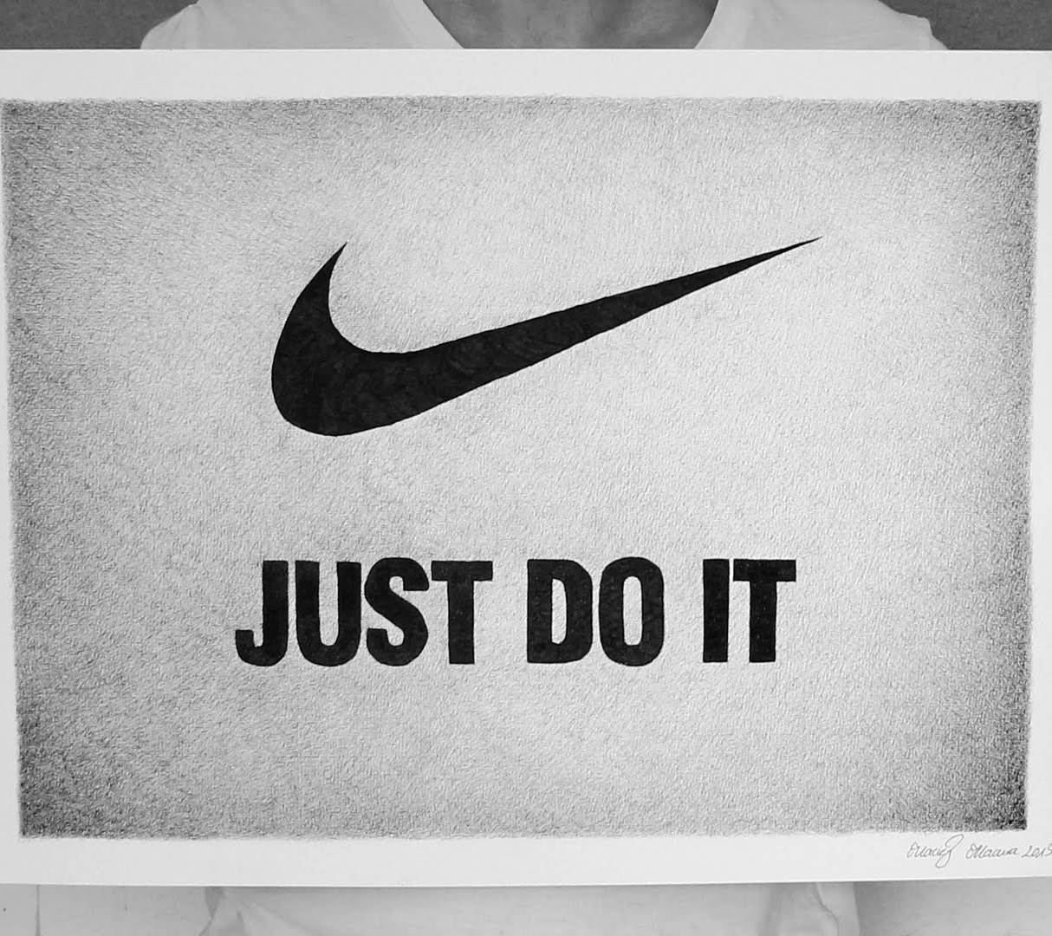
Nike
Here is where your presentation begins

Slide 2
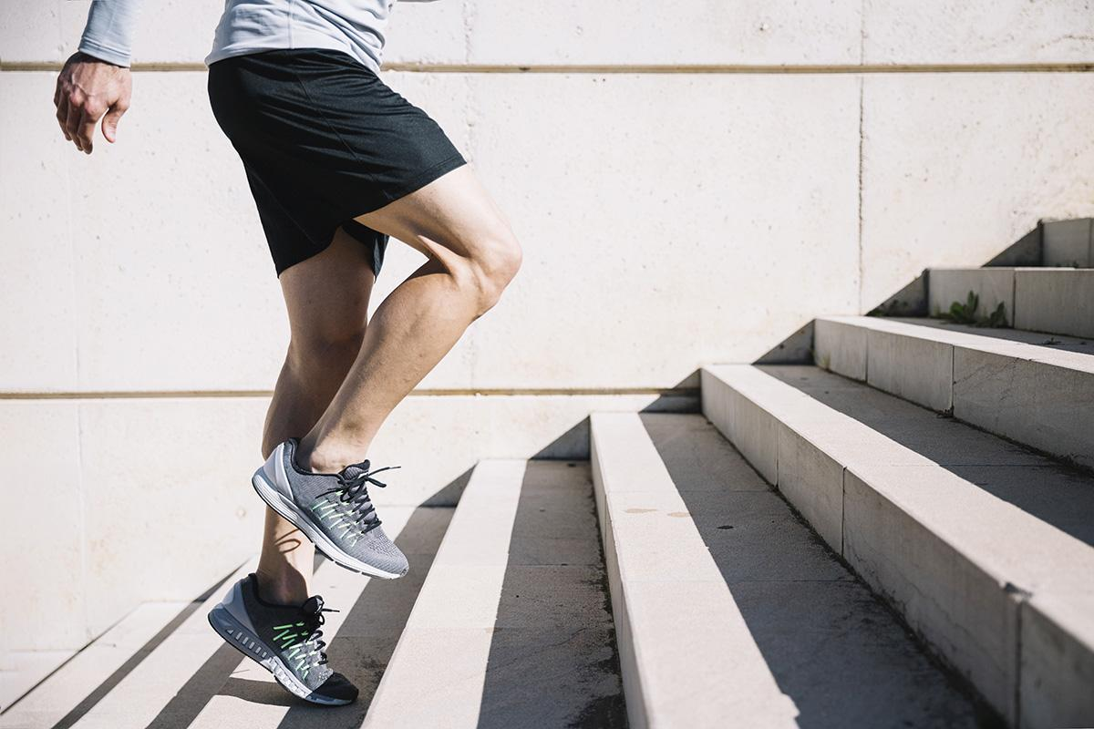
TABLE OF CONTENTS
01
02
03
04
SECTION 01
SECTION 02
Here you could describe the topic of the section
Here you could describe the topic of the section
SECTION 03
SECTION 04
Here you could describe the topic of the section
Here you could describe the topic of the section

Slide 3
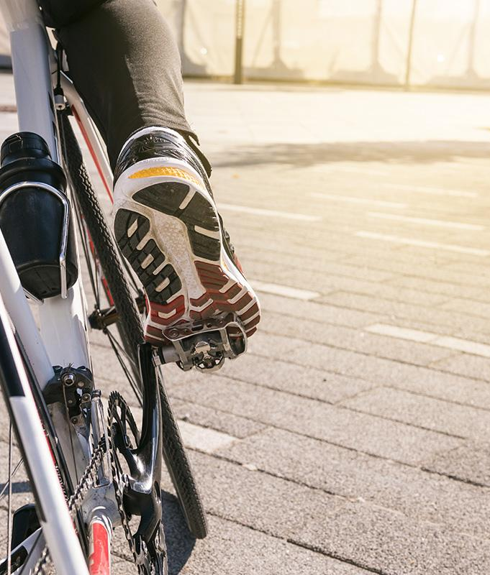
INTRODUCTION
Do you know what helps you make your point clear? Lists like this one:
They’re simple
You can organize your ideas clearly
You’ll never forget to buy milk!
The audience won’t miss the point of your presentation

Slide 4
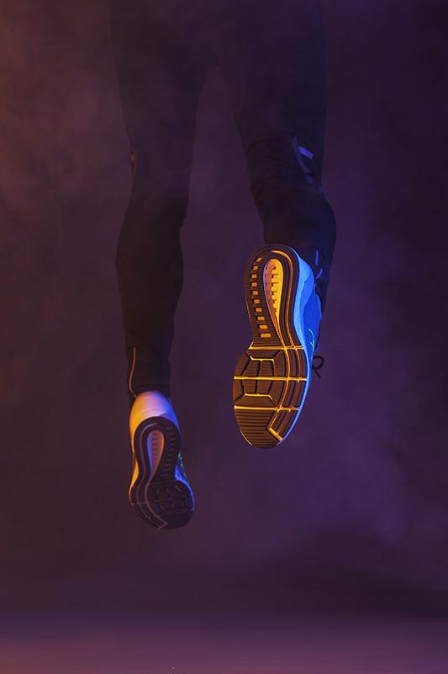
01
Orgnisational behaviour concerns
cultural diversity

Slide 5
COMPETITORS
Company name
COMPETITOR 01
Despite being red, Mars is actually a cold place
COMPETITOR 02
Company name
Mercury is the closest planet to the sun
COMPETITOR 03
Venus has a beautiful name, but it’s hot

Slide 6
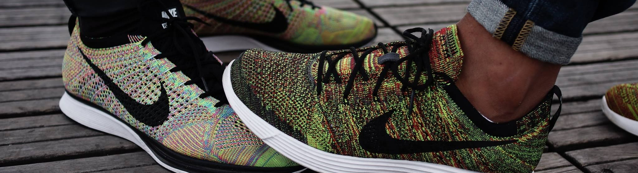
THE PROBLEM
Mercury is the closest planet to the Sun and the smallest one in the Solar System. It’s only a bit larger than the Moon.

Slide 7
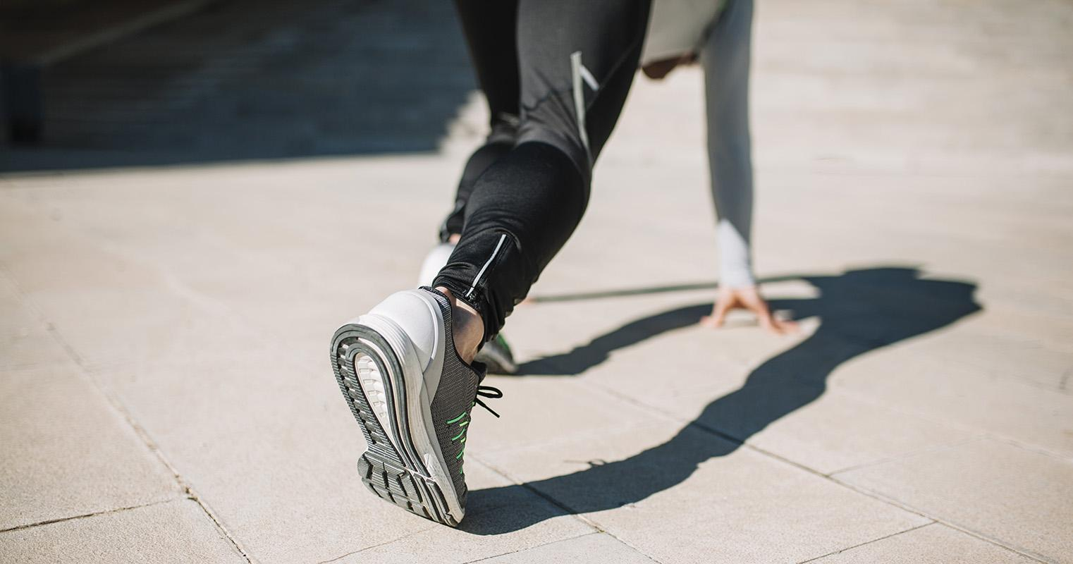
SOLUTION
Mercury is the closest planet to the Sun and the smallest one in the Solar System. It’s only a bit larger than the Moon.

Slide 8
CASE STUDY
01
02
03
04
Venus has a beautiful name but it’s terribly hot
Neptune is the farthest planet from the Sun
Mercury is the closest planet to the Sun
Despite being red, Mars is actually a cold place

Slide 9
REVIEWS
“
“
“
Mercury is the closest planet to the Sun
—Jane Doe
Venus has a beautiful name but it’s terribly hot
—John Smith
Despite being red, Mars is actually a cold place
—Kate Duff

Slide 10
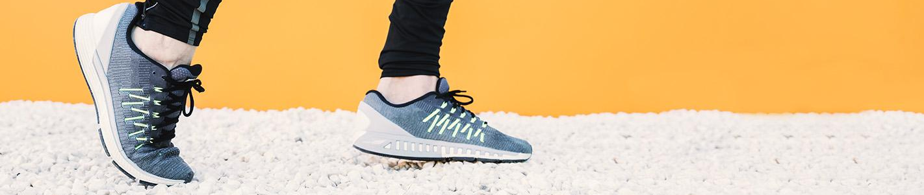
AWARDS
2016
2018
AWARD 01
AWARD 02
Despite being red, Mars is actually a cold place
Mercury is the closest planet to the Sun

Slide 11

THANKS
Do you have any questions?
Please keep this slide for attribution

Slide 12
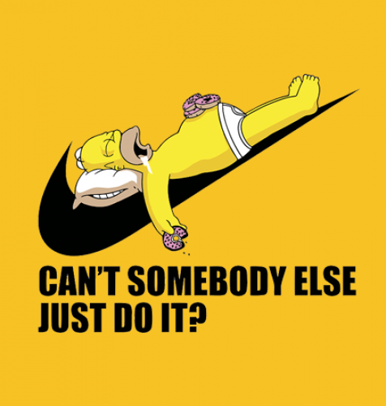
RESOURCES
VECTORS
Black ipad
Responsive web design technology
PHOTOS
Man balancing skateboard on railing
Close-up woman shoes for adventure
Woman sitting rug using smartphone listening music
Close-up female tying shoelaces
Top view arrow asphalt shoes
Crop person running on yellow background
Medium shot of man balancing on skateboard
Crop legs leaping in smoke

Slide 13
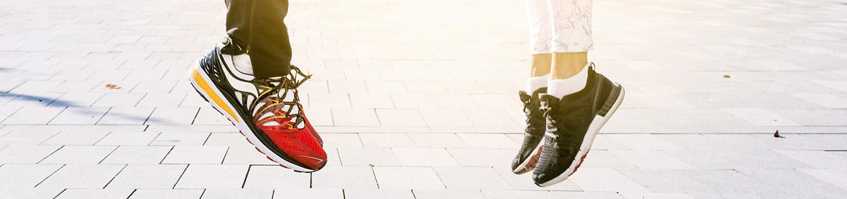
ALTERNATIVE RESOURCES
PHOTOS
Low section of fitness couple jumping in the air at outdoors
Close-up woman holding small shoe
Sport equipment
Woman tying her shoes in next to a building
Side view male basketball player tying shoe laces

