Slide 1
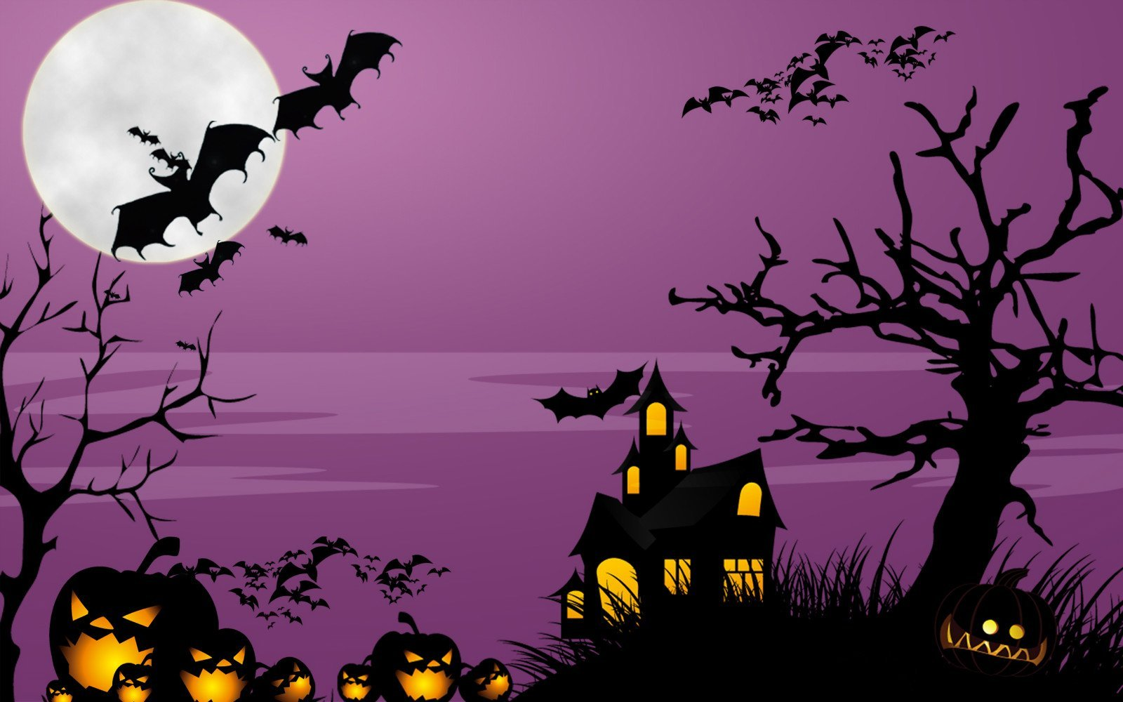

HALLOWEEN
click here to download more https://t.me/EnglishZonePowerPoints

Slide 2
LEARN THE WORDS

Slide 3

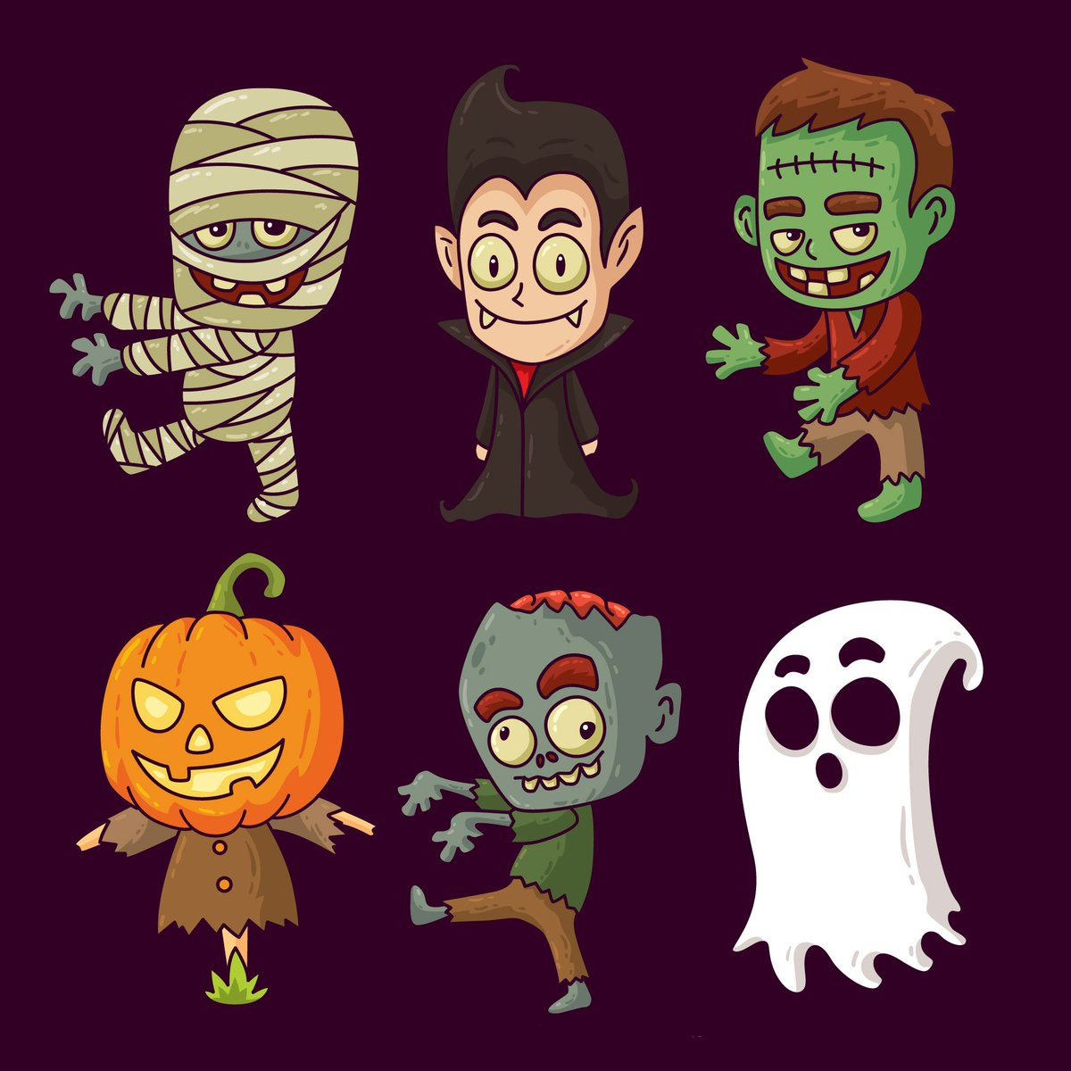
FRANKENSTEIN
click here to download more https://t.me/EnglishZonePowerPoints

Slide 4
MUMMY

Slide 5
VAMPIRE
click here to download more https://t.me/EnglishZonePowerPoints

Slide 6
GHOST

Slide 7
SCARECROW

Slide 8
ZOMBIE

Slide 9
MATCH

Slide 10
ZOMBIE
FRANKENSTEIN
GHOST
SCARECROW
VAMPIRE
MUMMY

Slide 11
UNSCRAMBLE

Slide 12
OBMIEZ
ZOMBIE
NNNKRAFIEETS
FRANKENSTEIN
THOGS
GHOST
WARCORCSE
SCARECROW
PRAIMVE
VAMPIRE
YUMMM
MUMMY
click here to download more https://t.me/EnglishZonePowerPoints

Slide 13


GREAT JOB

