Slide 1
The life of Sofiah G.D. Wembolenga

Slide 2
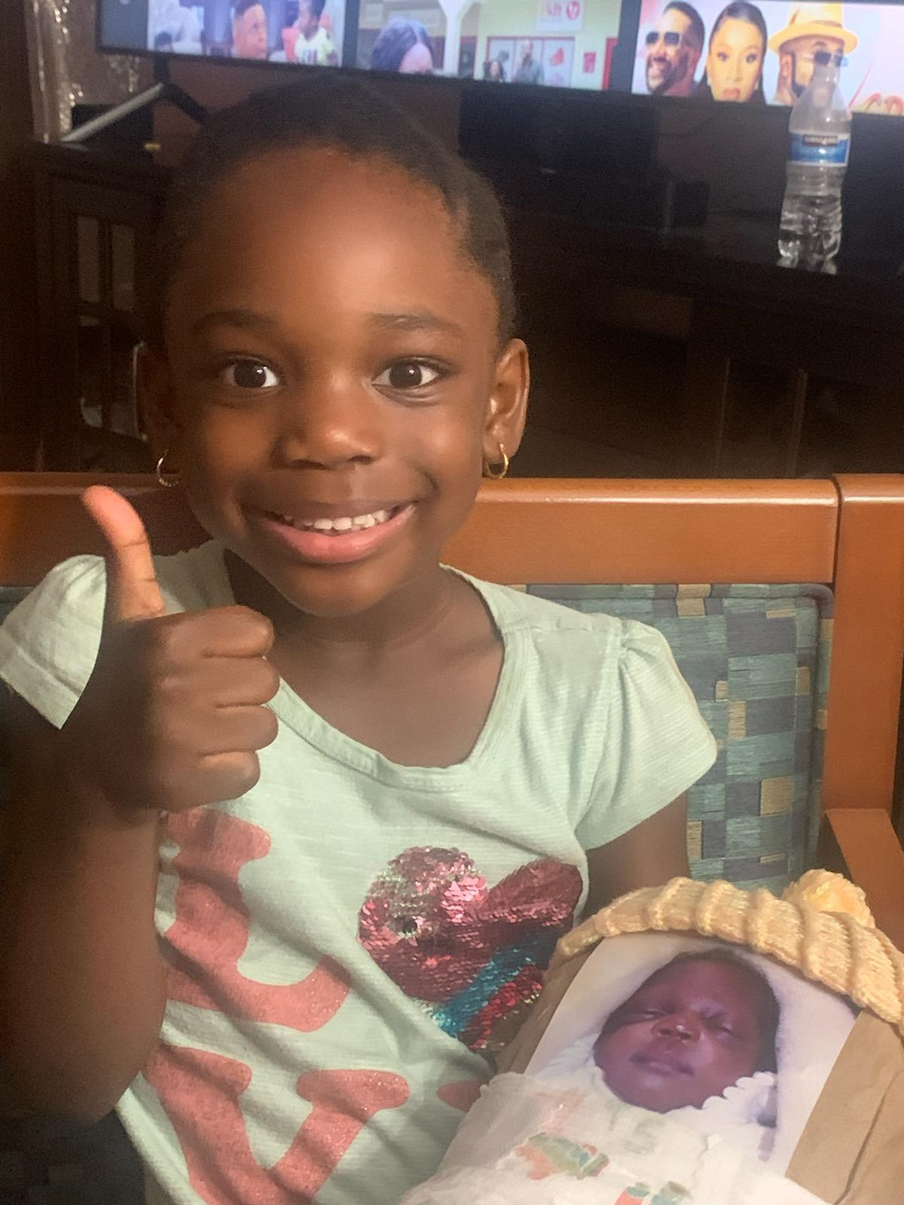
Day One
Welcome to the world Sofiah! Welcome to the world, you'll love it here:)) Here's a picture of your aunt holding you!

Slide 3
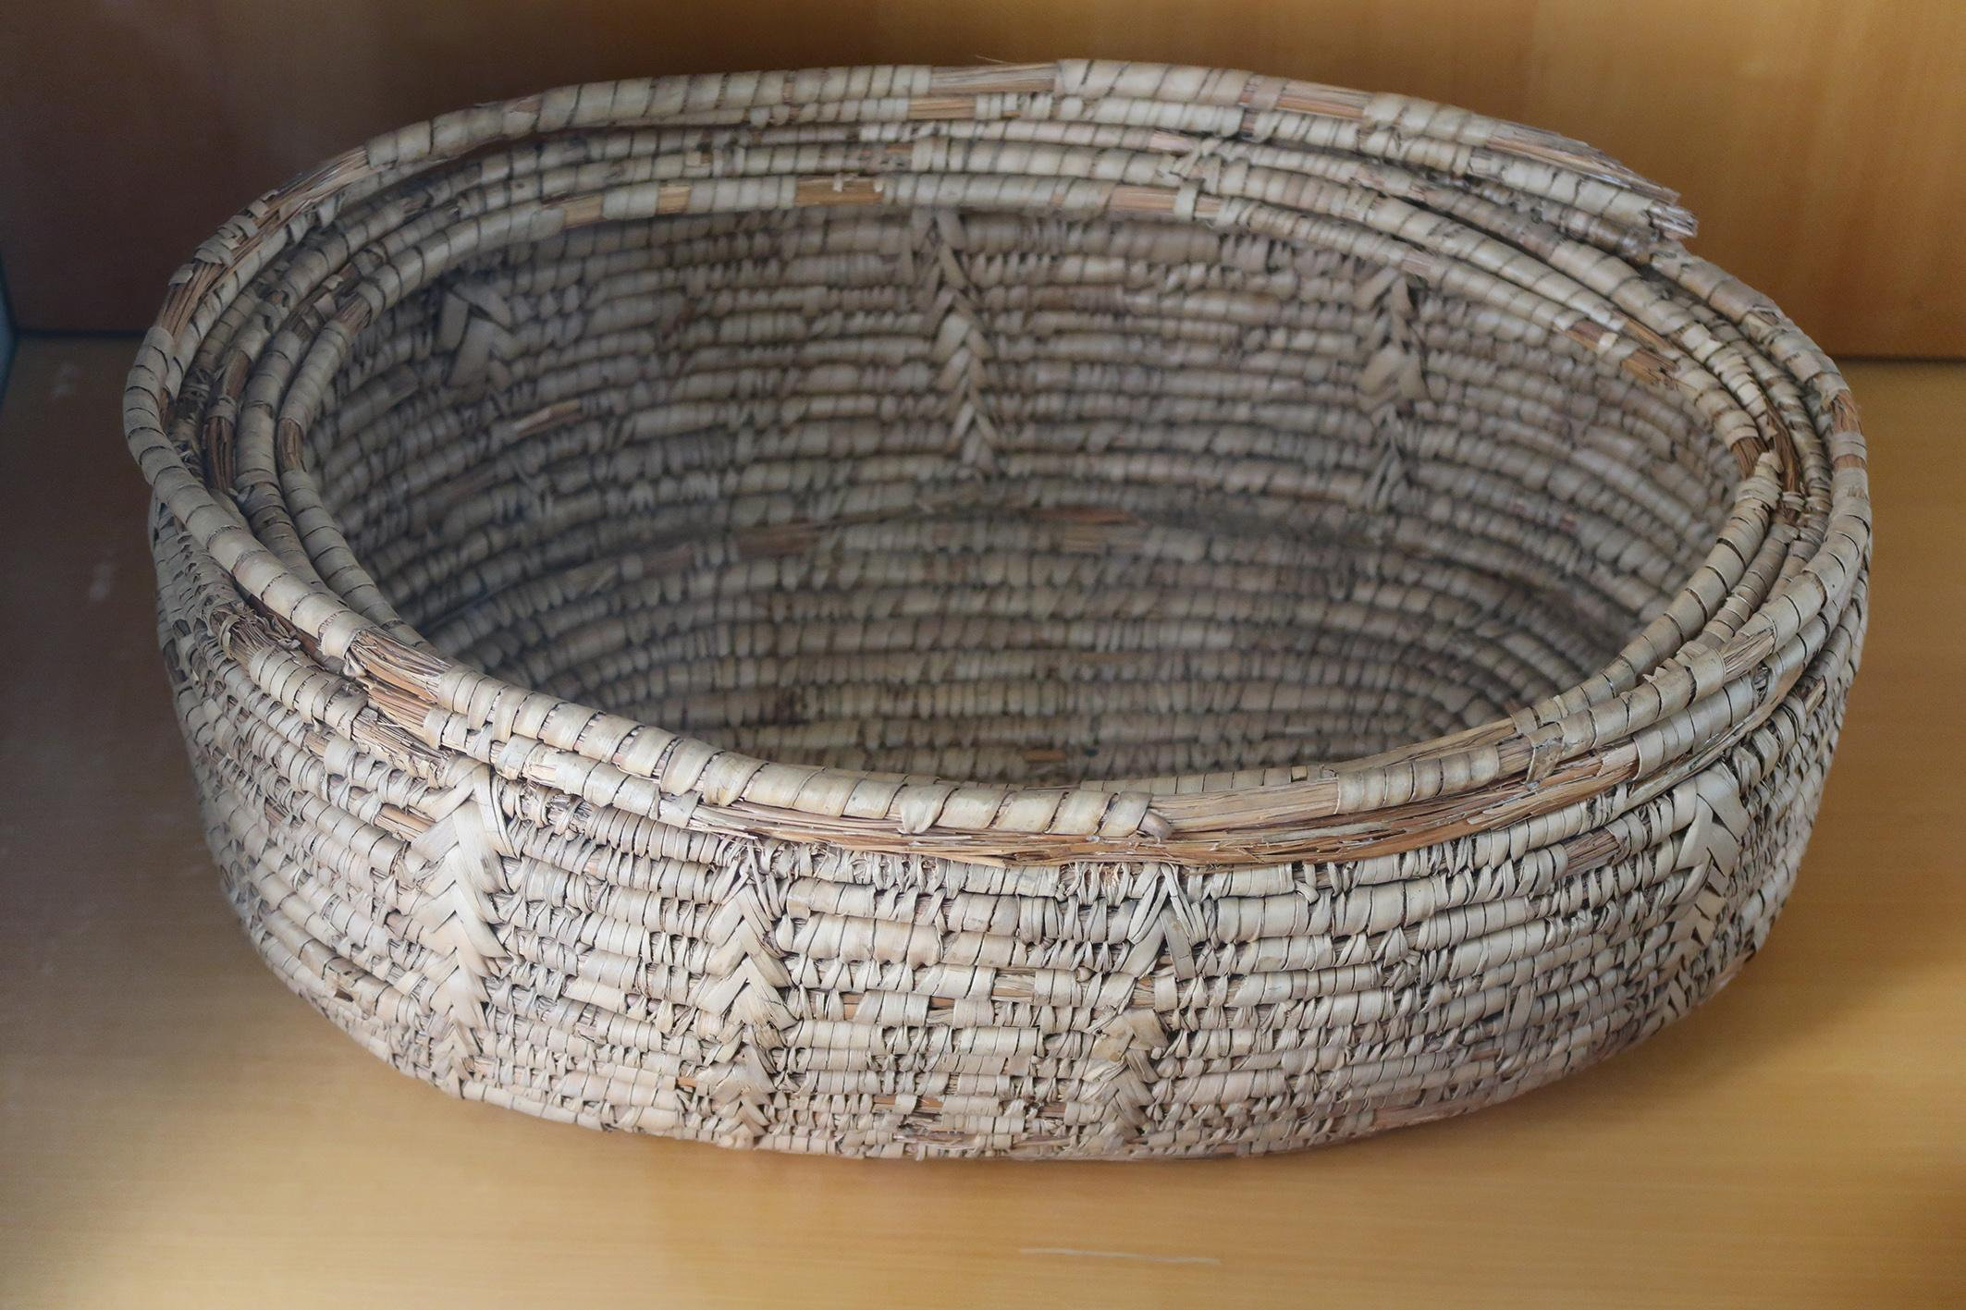
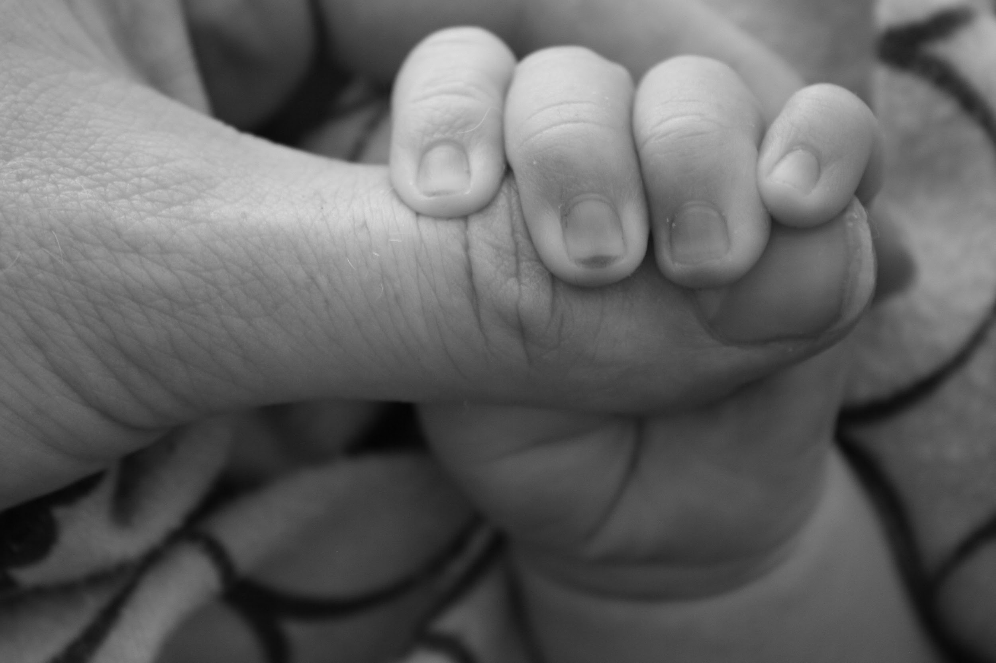
Day 2
Carrying you has been a struggle, especially since your basket is like the embodiment of the one from the Prince Of Egypt. But I love you regardless.
-Mama<3

Slide 4
Day Three
Your aunt, Teja, literally loves you to the moon, you’re so loved by everyone around you, especially me! Your godmothers, Vivian and Selena, finally met you today! They’ve never been happier:)

Slide 5
Day Four
Walking up the stairs and carrying you becomes harder and more difficult as the days pass, but that’s not going to stop me from caring about you. We saw Katy HS’s color-guard team perform today! It was so bright and colorful, I think you really enjoyed it.

Slide 6
Day Five
I needed a break today Sofiah, so aunt Teja took care of you today while we watched color- guard perform again today they were amazing as usual! But this performance was far more “punk” like and was it was nice seeing a different side of the color-guard!

Slide 7
Day Six
Oh my darling child, I cannot with how annoyed you made whenever you woke me up at 12:00 in the morning! It’s ok though, all I know is after I feed you I’ll be able to go back to sleep!

